Slide 1
SOEN 384
Management, Measurement and Quality Control http://users.encs.concordia.ca/~384_2/
Instructor: Dr. Olga Ormandjieva
Lecture 19:
Software Engineering Management (SEM) – Key Area 2: Risk management (2)
References:
Lecture Notes of Dr. Constantinides on Risk management
PMBok, Chapter 11
SWEBOK, Chapter 7
Project Risk Management, Bruce Barkley

Slide 2
Agenda
Definition of Risk Management
Risk Management process
Integrating risk management with project planning
Key points?
SOEN384-F15-19: risk management (2)

Slide 3
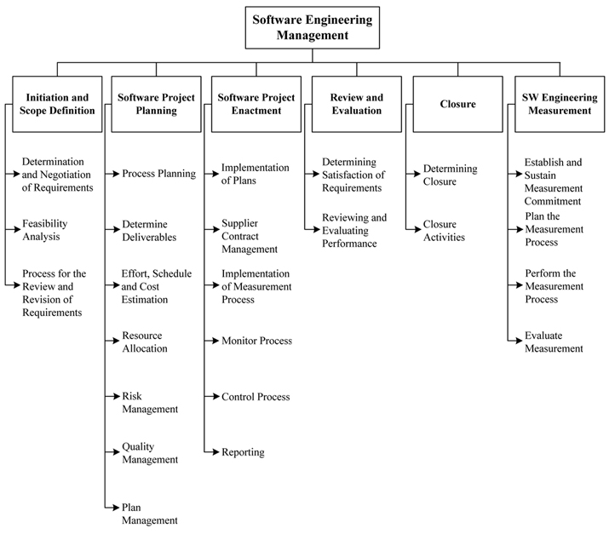
BREAKDOWN OF TOPICS FOR SOFTWARE ENGINEERING MANAGEMENT: SWEBOK
SOEN384-F15-19: risk management (2)

Slide 4
SWEBOK:
2.5. Risk Management
Risk identification and analysis (what can go wrong, how and why, and what are the likely consequences )
critical risk assessment (which are the most significant risks in terms of exposure, which can we do something about in terms of leverage),
risk mitigation and contingency planning (formulating a strategy to deal with risks and to manage the risk profile)
SOEN384-F15-19: risk management (2)

Slide 5
ISO/IEC Definitions
risk: The combination of the probability of an event and its negative consequence.
  1—The term “risk” is generally used only when there is at least the possibility of negative consequences.
  2—In some situations, risk arises from the possibility of deviation from the expected outcome or event.
risk category: A class or type of risk (e.g., technical, legal, organizational, safety, economic, engineering cost, schedule).
  NOTE—A risk category is a characterization of a source of risk.
SOEN384-F15-19: risk management (2)

Slide 6
Agenda
Definition of Risk Management
Risk Management process
Integrating risk management with project planning
Key points?
SOEN384-F15-19: risk management (2)

Slide 7
Risk Management process
Steps:
Risk assessment
Risk control
Risk assessment and risk control work together!
SOEN384-F15-19: risk management (2)

Slide 8
Risk assessment
Risk Identification
Risk analysis
Risk prioritization
Can be performed at the beginning of the project development and reassessed at the beginning of the iterations
SOEN384-F15-19: risk management (2)

Slide 9
Risk control
Risk planning and mitigation
  Can be performed at the beginning of the project development and reassessed at the beginning of the iterations
Resolution
  Can be performed throughout the project development
Risk monitoring
  Can be performed throughout the project development
SOEN384-F15-19: risk management (2)

Slide 10
Risk assessment: Risk identification
Risk identification: Identify risks related to the overall project, to the product and to the business.
The outcome of this step is a collection of risk items.
Example:
  You are a project manager and have been assigned to a high-profile, mission-critical project that has high-revenue potential in a new market segment.
  After an initial assessment, you have determined that it is a risky project since it relies heavily on new technology
SOEN384-F15-19: risk management (2)

Slide 11
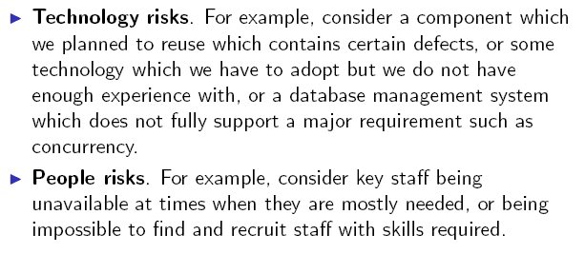
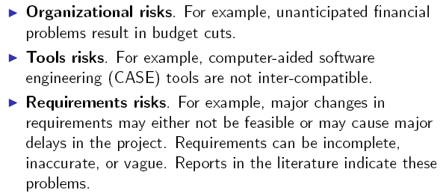
Risk Categories
(from the slides of Dr. Constantinides)
Estimation risks. For example, the time required to complete the project has been underestimated.
SOEN384-F15-19: risk management (2)
Notes:
Requirements risks: research by the Standish Group indicates the following
major reasons for the high failure rate in software
development:
Poor requirements.
Lack of understanding that cost and schedule are engineering
parameters based on requirements.
Lack of understanding and following a process and a life cycle.
The above studies indicate that the way we define, analyze,
and manage requirements is imposing serious risk to the
success of our software projects.

Slide 12
Risk assessment:
Risk analysis
Assess:
  the likelihood of occurrence
    Qualitative: Scale (for example: Low, Moderate, Significant, High)
    Quantitative: probability of occurrence
  the impact on project, product and business of each risk item
    Qualitative: Scale (for example: Low, Moderate, Significant, High)
    Quantitative: where data is available.
      Example: fire can cause 0.5 millions of damage in a facility
Which risks do we consider really serious?

Slide 13
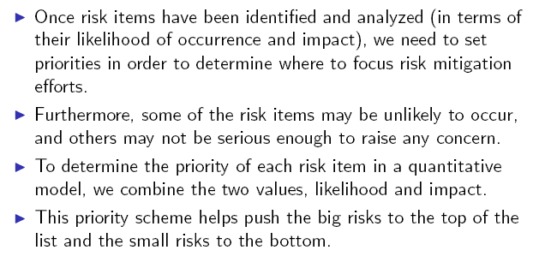
Risk assessment:
Risk prioritization
(from the slides of Dr. Constantinides)
SOEN384-F15-19: risk management (2)

Slide 14
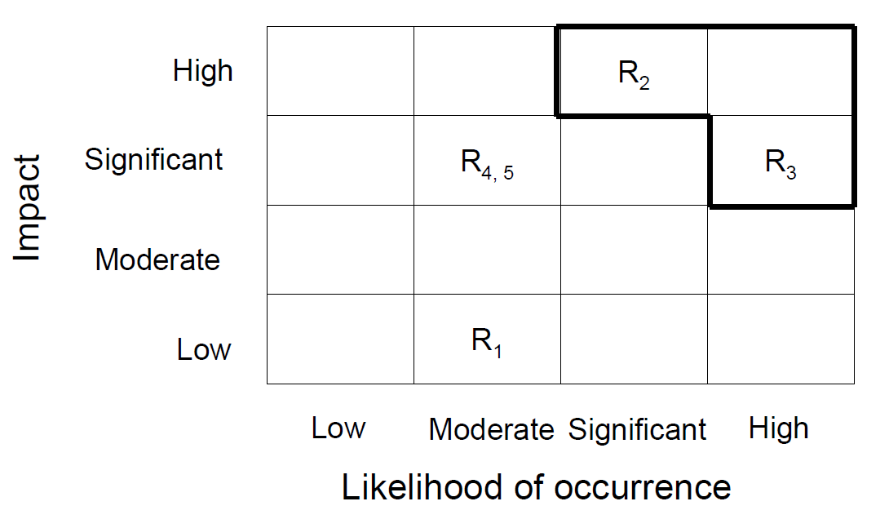
Impact v.s. Likelihood of Occurrence: Qualitative assessment
Risks of high concern
SOEN384-F15-19: risk management (2)

Slide 15
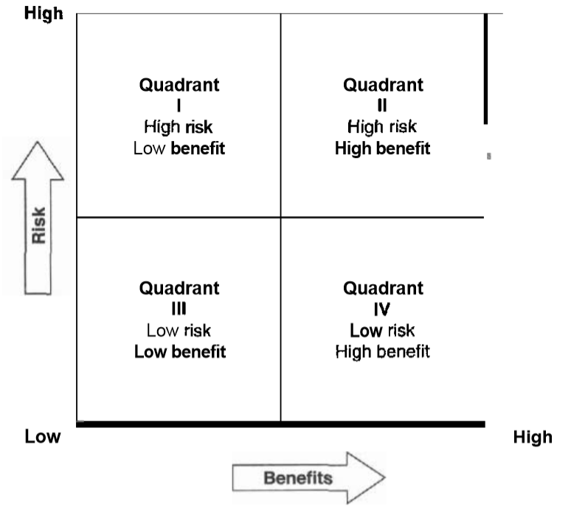
Risk/Benefits: tradeoffs
(“project Risk management”, Bruce Barkley)
SOEN384-F15-19: risk management (2)
Notes:
High risk, low benefit: Projects are not worth doing simply because there is meat uncertainty about outcomes and little foreseeable payoff.
High risk ,high benefit: the outcomes could substantially improve market share and profitability. Example: investment in the field of space exploration.
Low risk, low benefit: Projects are not worth doing because there is no foreseeable payoff.
Low risk, high benefit: Projects are very attractive. Example: installation of proven technology that promises to double productiity

Slide 16
Risk/Benefits: tradeoffs
(“project Risk management”, Bruce Barkley)
High risk, low benefit: Projects are not worth doing simply because there is meat uncertainty about outcomes and little foreseeable payoff.
High risk ,high benefit: the outcomes could substantially improve market share and profitability.
  Example: investment in the field of space exploration.
Low risk, low benefit: Projects are not worth doing because there is no foreseeable payoff.
Low risk, high benefit: Projects are very attractive.
  Example: installation of proven technology that promises to double productivity
SOEN384-F15-19: risk management (2)

Slide 17
Impact v.s. Likelihood of Occurrence: Quantitative assessment
Risk Exposure (RE) =
Risk-Probability * Risk-impact
Example:
  Loss of car: risk-impact is cost to replace car, e.g. $10,000
    Probability of car loss: 0.10
    Risk exposure or expected loss =
    10,000 x 0.10 = 1,000
Ranking of risk items can be done based on the RE

Slide 18
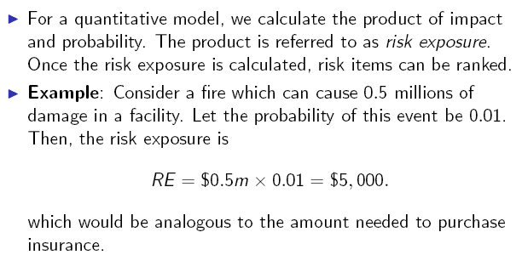
Quantitative model: example
(text from the slides of Dr. Constantinides)
Risk exposure =
risk probability x impact
SOEN384-F15-19: risk management (2)
Notes:
One limitation with the calculation of risk exposure is that it
assumes that the amount of damage sustained will always be
the same.

Slide 19
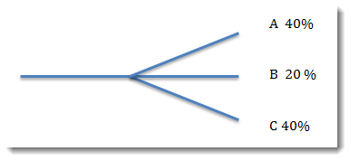
Decision tree analysis: a common Risk Analysis Tool
One of the most powerful tools for determining net outcomes from both positive and negative risk events
The decision tree is a diagram that describes a decision under consideration and the implications of choosing one or another of the available alternatives.
For any set of outcomes, the total probability is 100%
  Example: outcome A will happen 40% of the time, and outcome B will happen 20% of the time, then all other outcomes must occur 40% of the time in aggregate .
To determine the total impact, use the Risk Exposure for each branch of the decision tree (also named Expected Monetary Value EMV): EMV = P * I.
SOEN384-F15-19: risk management (2)

Slide 20
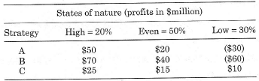
Decision Tree Analysis: Aims to uncover expected value of taking one path or another when a project “crossroad” decision must be made
Expected Monetary Value =
Probability_high * Impact_high + Probability_even * Impact_even + Probability_low * Impact_low
Exercise: given identified project risks, apply expected monetary value and decision tree techniques to evaluate likely project outcomes:
A company is planning a project to develop a new product and has identified 3 strategies it can use to bring the product to market – A, B, C.
3 possible states of nature are also identified – a low market demand, an even market demand, and a high market demand.
A payoff matrix with probabilities of each market condition has been developed:
Note: () indicate negative values
recommend what strategy the project should take (IN CLASS)

Slide 21
Decision Tree Analysis: more complex example
(“project Risk management”, Bruce Barkley)
Pat is a project manager with a local contractor who has submitted a proposal to install a telephone trunk line.
Pat has just received an option on 1000 acres of right-or-way property at $100/acre.
  If Pat purchases the option and the project is not selected, there is a 60% chance that she can sell the property at what it was bought for.
  Otherwise there is a 40% chance she can sell it at $90/acre.
Another option is to wait until the project is awarded to purchase the property:
  There is 20% chance that the property will increase to $120/acre.
There is a 60% chance that the company will be awarded the project.
The original proposal based on $100/acre netted the company a profit of $100,000
Decision required: To buy now or to buy later?
SOEN384-F15-19: risk management (2)

Slide 22
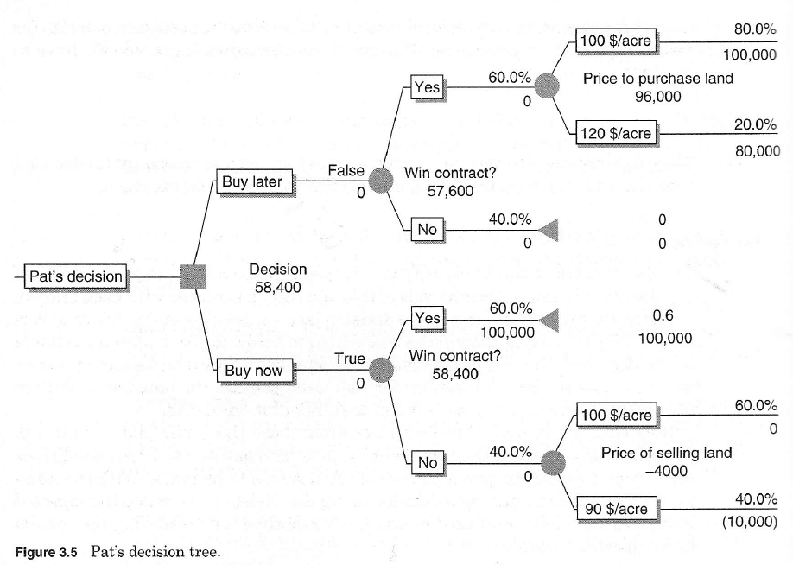
Decision Tree Analysis
(“project Risk management”, Bruce Barkley)
SOEN384-F15-19: risk management (2)

Slide 23
Decision tree analysis: key points
The decision tree is a diagram that describes a decision under consideration and the implications of choosing one or another of the available alternatives.
It incorporates probabilities of risks and the costs or rewards of each logical path of events and future decisions.
Solving the decision tree indicates which decision yields the greatest expected monetary value to the decision-maker when all the uncertain implications, costs, rewards, and subsequent decisions are quantified.
SOEN384-F15-19: risk management (2)

Slide 24
Risk Control:
Risk planning
Consider each negative risk item and develop a strategy to manage it
Types of strategies:
  Acceptance
  Avoidance
  Reduction
  Mitigation
  Risk transfer
Contingency measures

Slide 25
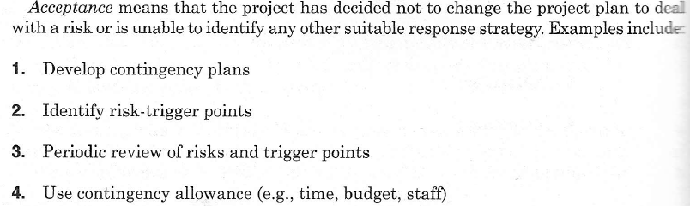
Risk response strategies: Acceptance
(“project Risk management”, Bruce Barkley)
SOEN384-F15-19: risk management (2)

Slide 26
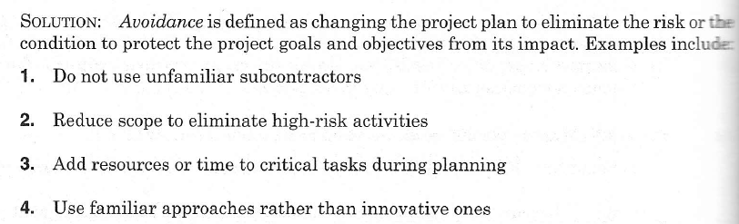
Risk response strategies: Avoidance
(“project Risk management”, Bruce Barkley)
SOEN384-F15-19: risk management (2)

Slide 27
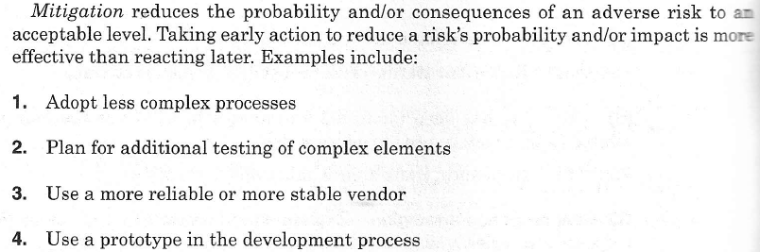
Risk response strategies: Mitigation
(“project Risk management”, Bruce Barkley)
SOEN384-F15-19: risk management (2)

Slide 28
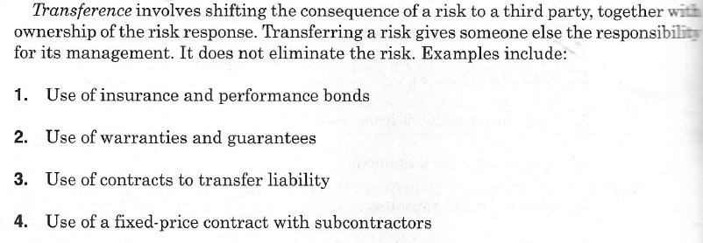
Risk response strategies: Transference
(“project Risk management”, Bruce Barkley)
SOEN384-F15-19: risk management (2)

Slide 29
Risk Control:
Risk mitigation
We can take measures to reduce the risk exposure factor of a given risk item.
However, we need to take into consideration that these measures contain cost:
Risk Reduction Leverage =
((risk exp. RE before) – (risk exp. RE after)) / (cost of reduction)

Slide 30
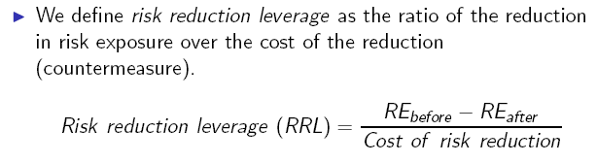
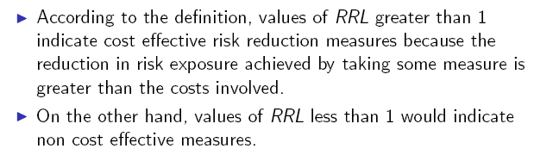
Risk reduction leverage (RRL)
(from the slides of Dr. Constantinides)
SOEN384-F15-19: risk management (2)
Notes:
We can take measures to reduce the risk exposure factor of a
given risk item. However, we need to take into consideration
that these measures contain cost.

Slide 31

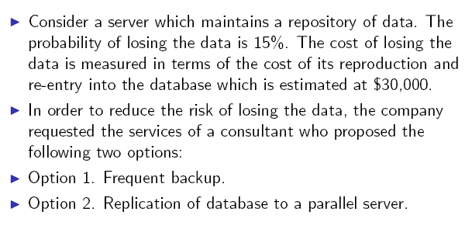
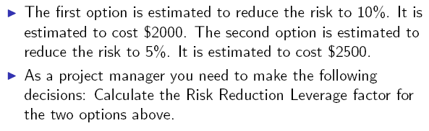
Risk reduction leverage (RRL) exercise
(from the slides of Dr. Constantinides)
RE = risk probability x amount at stake
Which option would you adopt, if any?
SOEN384-F15-19: risk management (2)

Slide 32
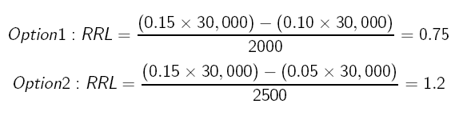
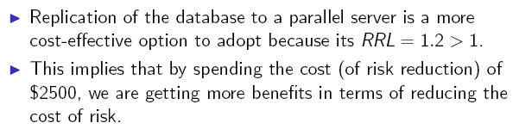
Risk reduction leverage (RRL) exercise - answer
(from the slides of Dr. Constantinides)
RE = risk probability x amount at stake
SOEN384-F15-19: risk management (2)
Notes:
We can take measures to reduce the risk exposure factor of a
given risk item. However, we need to take into consideration
that these measures contain cost.

Slide 33
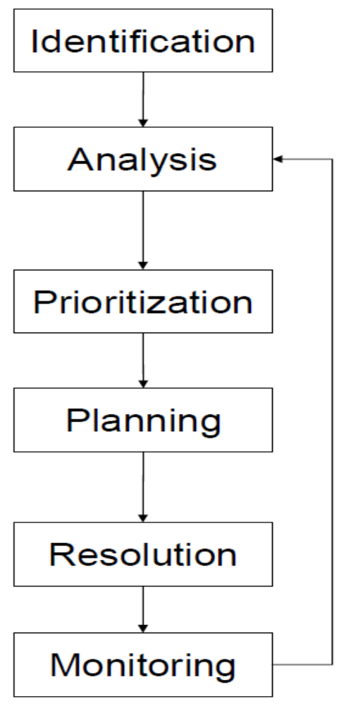
Risk Control: Risk monitoring
Establish thresholds that can indicate for each risk item when we should act
Track the risks and take action when necessary
  Do certain risk items manifest themselves over various iterations?
  Do we need to re-prioritize risk items?
  Have new risks been discovered?
SOEN384-F15-19: risk management (2)

Slide 34
Risk monitoring & Controlling (see PMBok, chapter 11)
Project risk response audits
  Examining and documenting the effectiveness of risk responses in dealing with identified risks. Their root causes, and the risk management process
  PM should make sure it is done regularly
  Should have clear format and objectives
Periodic project risk reviews
  Identification of new risks
  Reassessment of current risks
  Closing outdated risks
Additional risk response planning
SOEN384-F15-19: risk management (2)

Slide 35
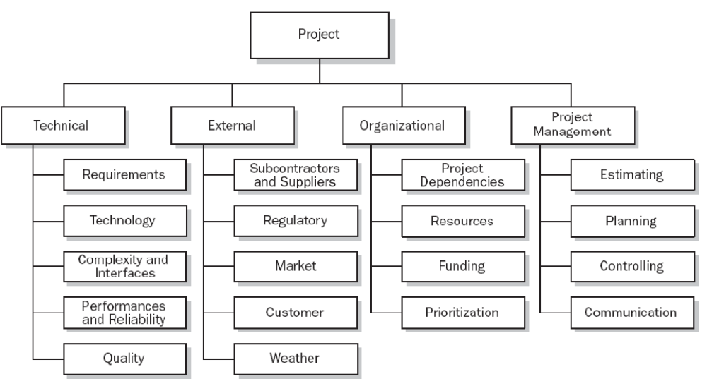
Risk Breakdown Stricture (RBS): PMBok
SOEN384-F15-19: risk management (2)
Notes:
RBS is helpful for risk identification of the many sources from which project risk may arise. It lists the categories and sub-categories within which risks may arise for a typical project. Different RBS will be appropriate for different types of projects.

Slide 36
SUMMARY FOR MANAGING RISKS
Jim McDonald, Monmouth University
Brainstorm possible risk items
Quantify their impact
Develop countermeasures
Track and act when necessary
Implement Risk Management as a
Part of Project Management
Notes:
28
28
28
27
27

Slide 37
Integrating risk management with project planning
software life cycle processes are evaluated and the most appropriate (given the nature of the project, its degree of novelty, its functional and technical complexity, its quality requirements, and so on) is selected.
the project itself is then planned in the form of a hierarchical decomposition of tasks, the associated deliverables of each task are specified and characterized in terms of quality and other attributes in line with stated requirements, and detailed effort, schedule, and cost estimation is undertaken.
Resources are then allocated to tasks so as to optimize personnel productivity (at individual, team, and organizational levels), equipment and materials utilization, and adherence to schedule.
Detailed risk management is undertaken and the "risk profile" of the project is discussed among, and accepted by, all relevant stakeholders.
SOEN384-F15-19: risk management (2)

Slide 38
Risk management plan
Roles and responsibilities
risk analysis definitions
timing for reviews
risk thresholds for low, moderate, and high risks
SOEN384-F15-19: risk management (2)

Slide 39
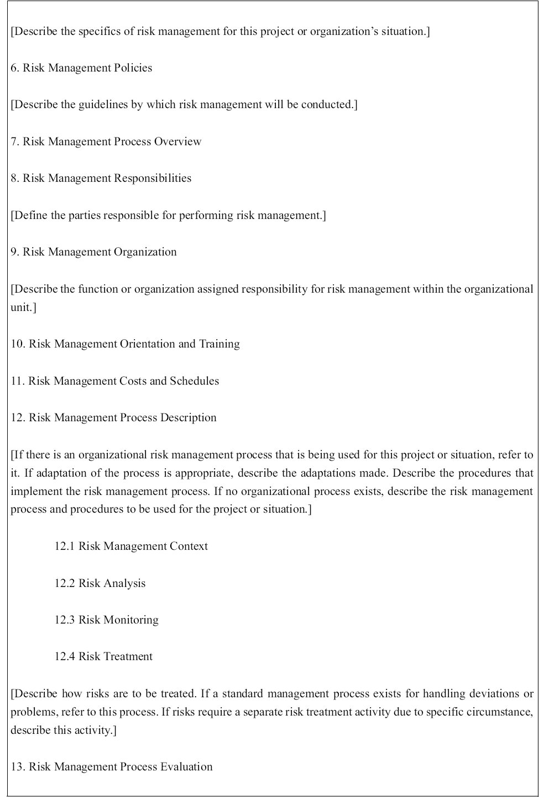
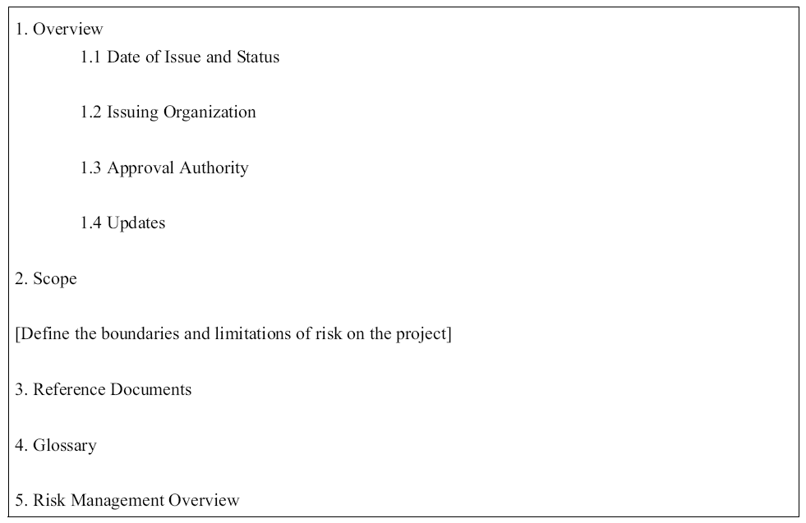

ISO/IEC 16085:
Outline of the risk management plan

Slide 40
Risk management plan
(ISO/IEC 16085:2006 Annex A)
Download Reading material 2 - Lecture 19 from the course webpage
Sample exam question: list the sections of the risk management plan and give an example for each section
SOEN384-F15-19: risk management (2)

Slide 41
More Exercises
Tutorial next week
SOEN384-F15-19: risk management (2)

Slide 42
Questions?
…
SOEN384-F15-19: risk management (2)

Slide 43
Next?
Agile management
November 25th: Quiz on Agile Estimation and Planning, 12% of the final mark. In class, 45 min
  Instead of the remaining homework
SOEN384-F15-19: risk management (2)

